Slide 1
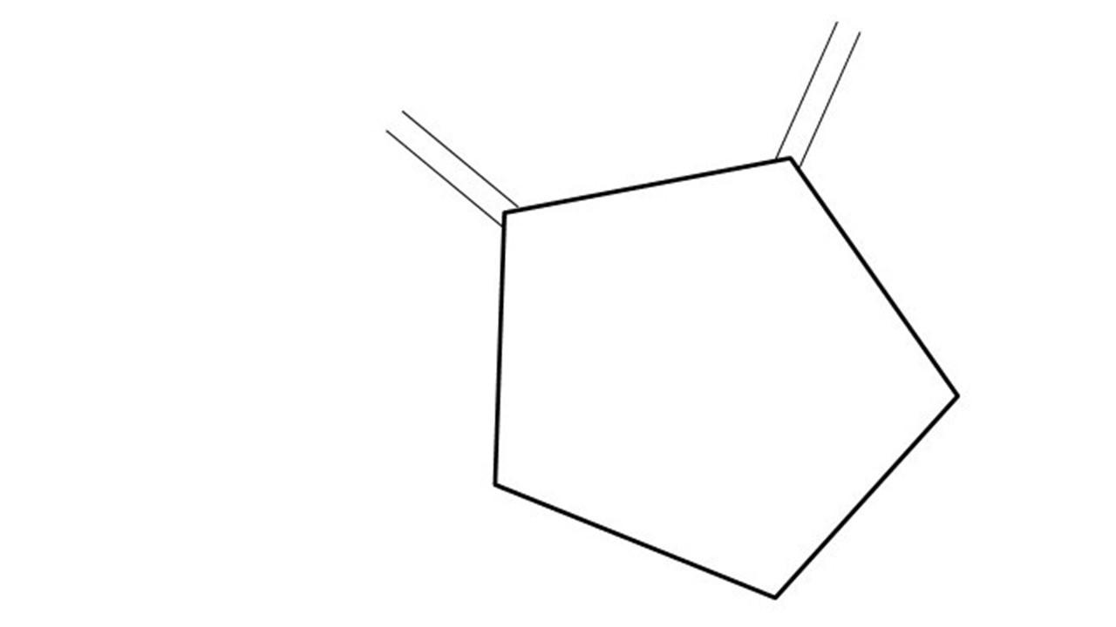
Great Cow BASIC Part 4
Great Cow BASIC for the PIC16F171xx chip Family
Oct 2022

Slide 2
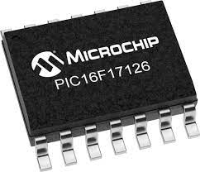
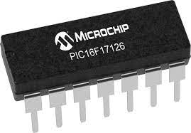
PIC16F17126
PIC16F171xx is a high performance PIC16
Digital and Analog peripherals
12-bit ADC
Multiple communication interfaces
Serial, I2C, SPI
PWM – CCP/PWM and 16Bit
Configurable Logic Cells
OpAmp
The PIC16F171xx offers 8 to 20 pin products in small footprint packages to support customers in a variety of space constrained and sensor node applications.

Slide 3
Videos...
Install the hardware and make the board work – three LED programs
Make four LEDs flash in a sequence
Set the LEDs to represent the value of ADC
Sequence the LEDs with a delay using the value of ADC
Using an input to set the state of the LEDs
Using the reset switch
Using the switch, ADC – may the LEDs flash in a sequence with reverse
Using the serial to display values
Using the timer0 overflow, 8bit timer, 16bit timer to flash the LEDs
Using CCP/PWM to dim the LEDS
Using I2C with serial to discover I2C devices
Using EEProm – showing values on the serial terminal
Using an I2C GCLD display
Using an SPI GCLD display
Using PWM to dim the LEDS
Using memory within the PIC – Progmem and SAF memory
The Great Cow BASIC tool chain
Assembly and alternatives assemblers
Summary

Slide 4
Great Cow BASIC Compiler
Great Cow BASIC is an Open Source compiler for PIC and AVR microcontrollers
Great Cow BASIC now supports the 16F171xx chip family
Great Cow BASIC Compiler

Slide 5
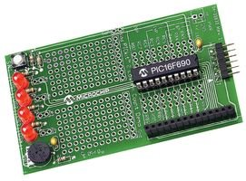
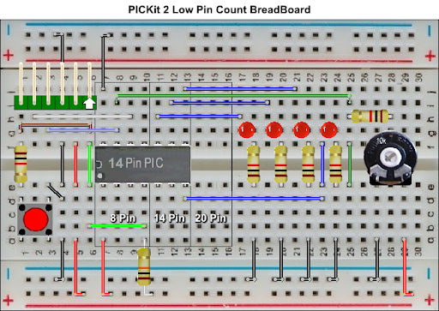

Hardware
Microchip Low Pin Count Demo Board
PICKit_2_Low_Pin_Count_User_Guide_51556a.pdf
By Chris Roper

Slide 6
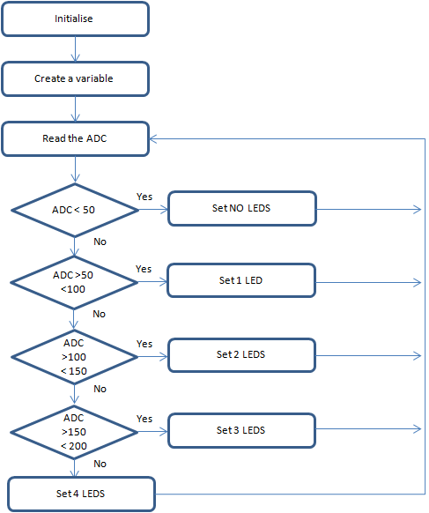
Overview
Great Cow BASIC completes the initialisation
Create a variable to store the ADC results
Read the ADC
Great Cow BASIC makes the process easy via the ReadADC12() - a value of 0 to 4095
Wait for a time period based on ADC
Set the LEDs
Do it again….and, again

Slide 7
Time
This tutorial combines previous tutorials by using WAIT() to control the speed of LED rotation based on the ADC value.
Where speed is a time delay
us, 10us, ms, 10ms, s, m or h
wait time unit - wait 1 ms
Where the code, by Great Cow BASIC, generated is a function of the frequency of the microcontroller automatically

Slide 8
Flow
Initialise
Set 1st LED
Time delays are sometimes key to the operation of a program
Read ADC 12 bit
( 0 – 4095 )
Wait for a Delay
Rotate the LEDs
Did it overflow ?
No
Yes
Set 1st LED

Slide 9
Lab
Examine the sample code
Review the results

Slide 11
Scale
Initialise
Set 1st LED
Scale transforms an existing value to a new value within a specified scale
Read ADC
Wait for a Delay
Scale()
Rotate the LEDs
Did it overflow ?
No
Yes
Set 1st LED

Slide 12
Lab
Revise the sample code
Review the results

Slide 14
Videos...
Install the hardware and make the board work – three LED programs
Make four LEDs flash in a sequence
Set the LEDs to represent the value of ADC
Sequence the LEDs with a delay using the value of ADC
Using an input to set the state of the LEDs
Using the reset switch
Using the switch, ADC – may the LEDs flash in a sequence with reverse
Using the serial to display values
Using the timer0 overflow, 8bit timer, 16bit timer to flash the LEDs
Using CCP/PWM to dim the LEDS
Using I2C with serial to discover I2C devices
Using EEProm – showing values on the serial terminal
Using an I2C GCLD display
Using an SPI GCLD display
Using PWM to dim the LEDS
Using memory within the PIC – Progmem and SAF memory
The Great Cow BASIC tool chain
Assembly and alternatives assemblers
Summary

Slide 15
Great Cow BASIC
Great Cow BASIC for the PIC16F171xx chip Family
Oct 2022

Slide 16
Backup Slides

Slide 17
Initialise
Set 1st LED
Wait for a Delay
Rotate the LEDs
Did it overflow ?
No
Yes
Set 1st LED

Slide 18
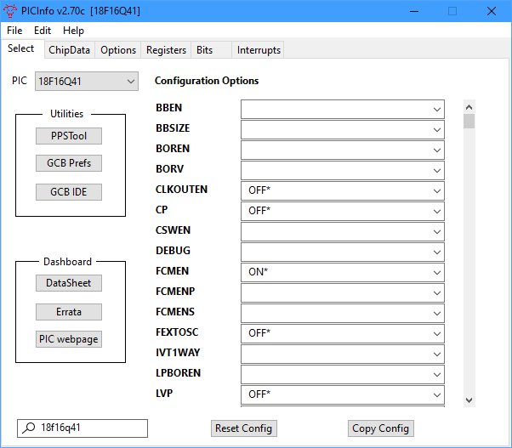
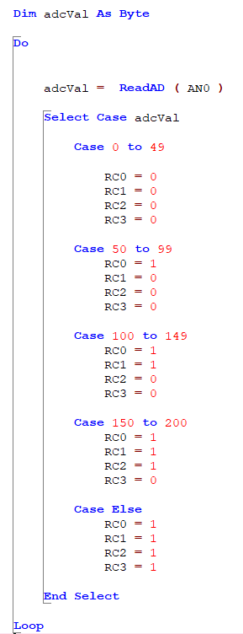
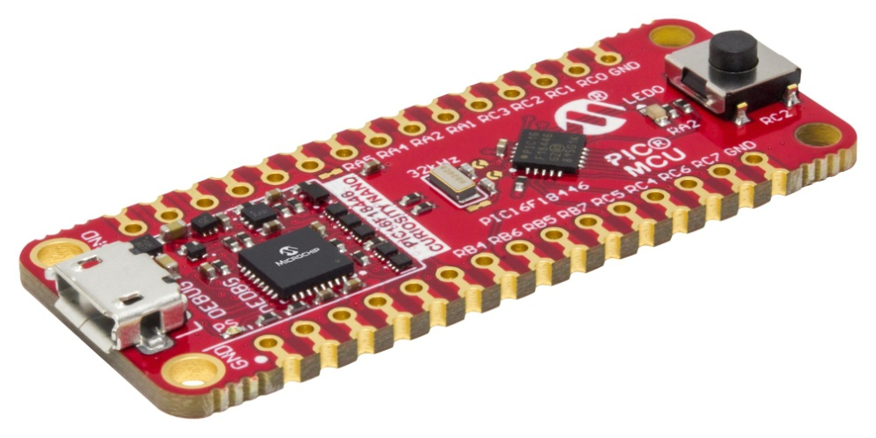
Analog-to-Digital

